Slide 1

Interview.io: Just 10 Questions to Ace Your Dream Job Interview
Smarter. Faster. Personalized. Powered by AI.
Stop telling ChatGPT to ask you questions like an interviewer. We Created a real Interviewer that can tell you exactly what's missing in your prep.

Slide 2

Final Year Students face a BIG Dilemma..
Prepping for an Interview. They all study the same old questions
Generic Questions Waste Time
Lacks Tailored Feedback
Repeated questions and standard lists don't align with specific job descriptions (JDs) or company culture.
Candidates receive vague, subjective advice instead of precise, data-driven insights on weak spots like tone, structure, or technical depth.
No Real-Time Evaluation
Overwhelming for All
Static prep materials offer zero simulation of the pressure and dynamic response needed during a live interview.
The sheer volume of content is daunting, creating anxiety for both fresh graduates and seasoned professionals looking for a career change.

Slide 3
Interview Preparation Should Adapt to YOU.
We believe the path to getting hired is unique to the candidate. Generic tools cannot meet this fundamental need for deep personalization.
Every Candidate’s Journey is Unique
Skills, Goals, and Roles Differ Greatly
Preparation Must Reflect That
Our AI engine designs a custom curriculum on the fly, ensuring every minute spent practicing is relevant and high-impact.
A platform must recognize and leverage the individual's background, experience level, and learning style.
Preparation must be hyper-focused on the exact technical, behavioral, and cultural requirements of the target role and company.

Slide 4






Meet Interview.io— Not a coach. Your Prep Mate.
We leverage advanced AI to transform vague preparation into a specific, high-fidelity simulation and feedback loop.
Personalized Simulations
Real-Time Question Generation & Scoring
Generate interview flows based on your uploaded resume, specific Job Description (JD), or even just a text profile.
The AI adapts its questioning based on your previous answers, scoring your performance instantly against a rubric.
Actionable Feedback for Growth
Works Flexibly for All
Receive detailed reports covering content, delivery, structure, and suggested study materials for immediate improvement.
The system is robust enough to provide valuable simulations even if you only input a few key skills or a target job title.

Slide 5





From Profile to Feedback — All in One Flow
Our five-step process ensures a seamless, guided experience that mirrors the real-world hiring process while optimizing for learning.
Enter Profile Data
Upload resume or paste job description to define the interview context.
Choose Domain
Select technical, behavioral, or cultural focus for the session.
AI takes your Interview
InterviewerAgent creates a hyper-relevant question path tailored to the inputs.
Answers, Scores, Summarizes your Performance
User answers are processed instantly for quality and relevance.
Get Insights & Reports
Receive a comprehensive performance report and personalized study plan.

Slide 6

Inside the Engine: How the Bot Thinks
Our modular, scalable architecture ensures high performance, context retention, and extremely accurate semantic analysis.
Feedback Engine
User input
Final output and scoring
Text submitted via UI
SentenceTransformer
Streamlit UI
Inside Int.io Engine
Captures and sends input
Embeddings for retrieval
ChromaDB
InterviewerAgent
Persistent semantic store
Core processing and routing
Key Components
ChromaDB & SentenceTransformer: Handles vector storage and semantic comparison for deep understanding of technical answers.
Session State: Manages user conversational context and interview progression.
Feedback Engine: Applies scoring rubrics and generates comprehensive, actionable advice.
InterviewerAgent: The core decision-making unit for question generation and answer analysis.

Slide 7






Built on a Robust AI Foundation
We leverage cutting-edge open-source tools and proven libraries to ensure reliability, security, and real-time processing capabilities.
Open-Source Efficiency
Advanced Semantics
Real-Time Performance
Utilizing Python and Streamlit allows for rapid prototyping and deployment with low overhead.
Sentence-transformers (MiniLM) and ChromaDB enable nuanced technical understanding beyond keyword matching.
Optimized architecture ensures minimal latency, delivering instant feedback critical for a smooth user experience.

Slide 8
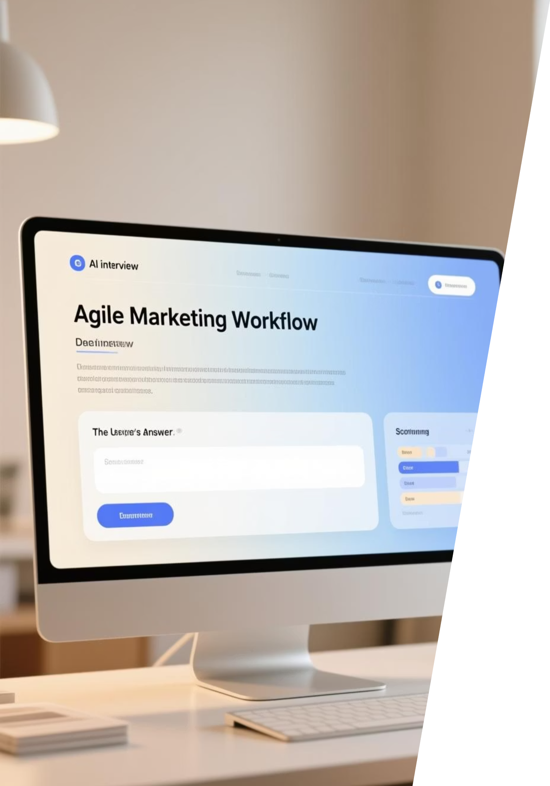
Your Interview, Simulated
Interview.io creates a high-fidelity simulation where the conversation flows naturally and the AI challenges the user's weak points.
Example Scenario: Marketing Manager
The user uploads a resume focused on digital campaigns. The AI immediately begins asking hyper-specific, role-based questions on budget allocation and KPI optimization, providing instant scoring on clarity and strategic thinking.
Explain how realistic and adaptive the simulation feels to users, highlighting the instant, context-aware scoring.

Slide 9




Empowering Every Job Seeker
Our platform addresses critical needs across the employment spectrum, from academic entry to high-level career pivots.
Students for Campus Placements
Professionals Switching Careers
Gaining confidence and mastering basic interview structures before entering the job market.
Adapting established skills to new industry terminology and expected behavioral responses.
General Job Seekers
Recruiters & Trainers
A reliable, always-available coach to improve overall communication and presentation skills.
Standardizing pre-interview candidate screening and providing measurable skill gap analysis.

Slide 10





Scaling to the Future of Interview Prep
Our roadmap is focused on expanding accessibility, deepening simulation realism, and integrating with the hiring ecosystem.
Voice-Based Interviews
Adding latency analysis and tone scoring for full conversational realism.
Job Board Integration
Directly importing JDs and instantly creating prep sessions from popular platforms.
Multi-Language Support
Expanding the model to support global users and multilingual hiring markets.
Enterprise Training Mode
Custom organizational training modules and centralized analytics for corporate clients.

